Slide 1
Test Case Logs
Common Test Cases

Slide 2
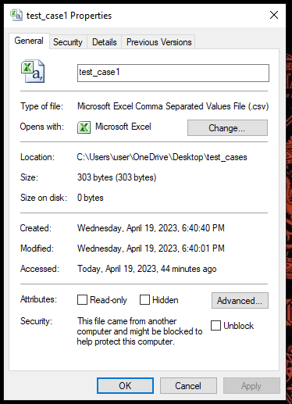

Test case 1
Validating the file that is within the size limit
File:
Config:

Slide 3
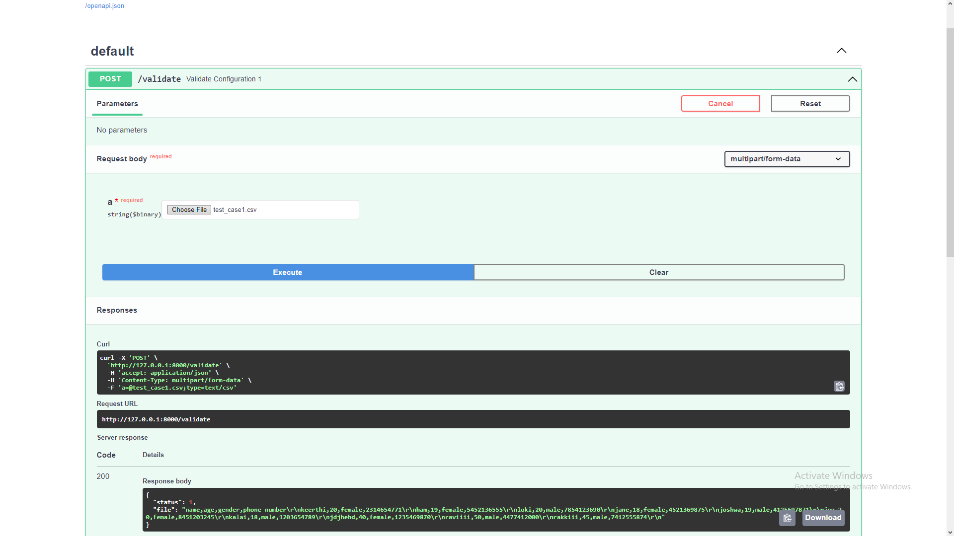
Output:

Slide 4
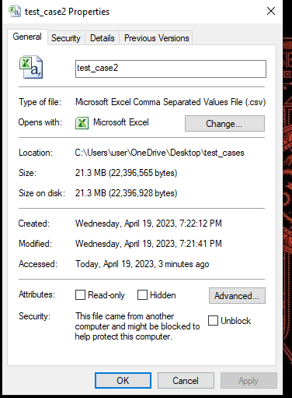

Test case 2
Validating the file that is above the size limit
File:
Config:

Slide 5
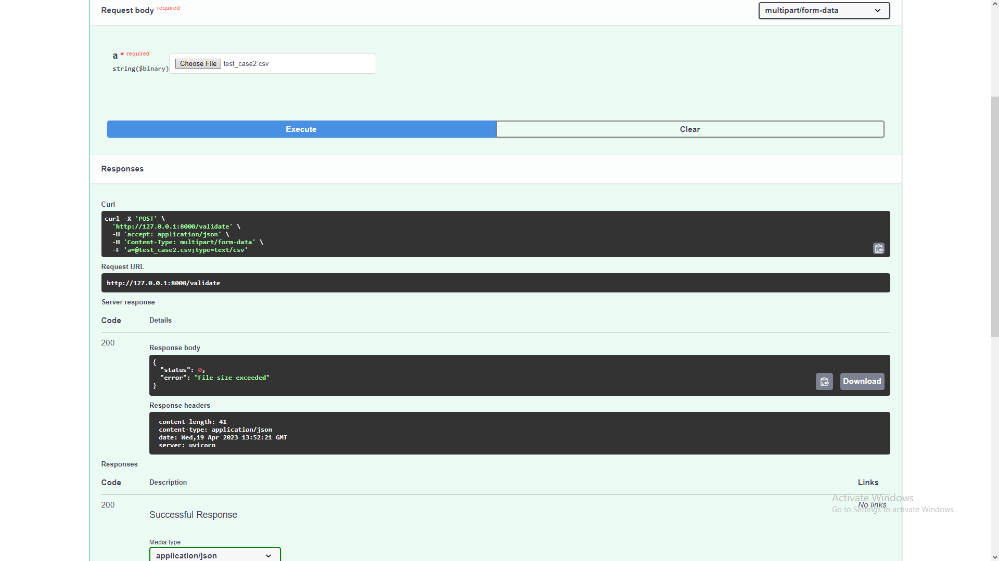
Output:

Slide 6
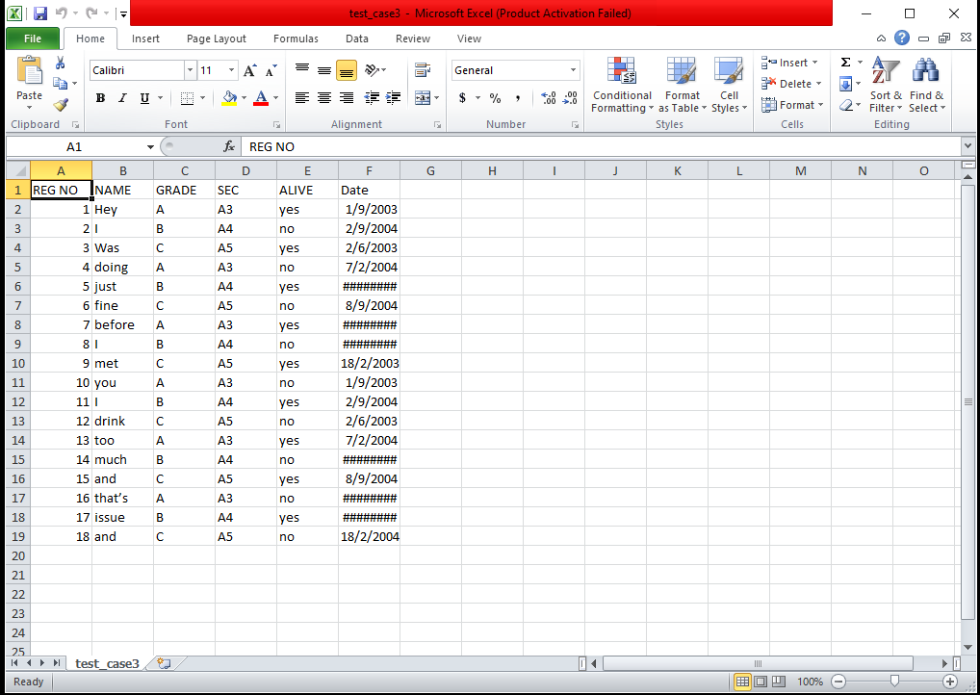
Test case 3
Validating a corrupted file
File:

Slide 7

Output:

Slide 8
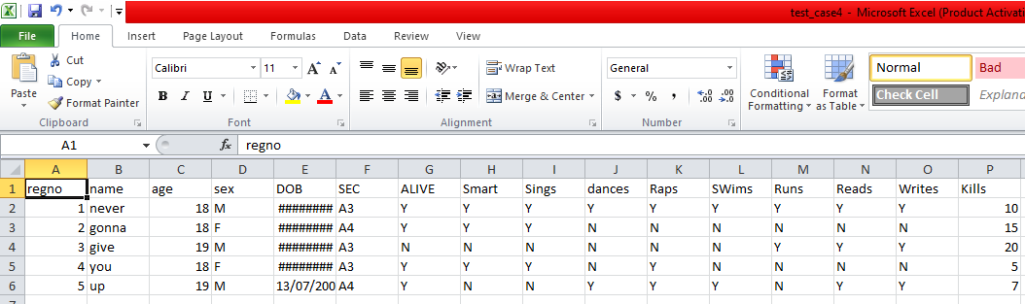
Test case 4
Validating an uncorrupted file
File:

Slide 9
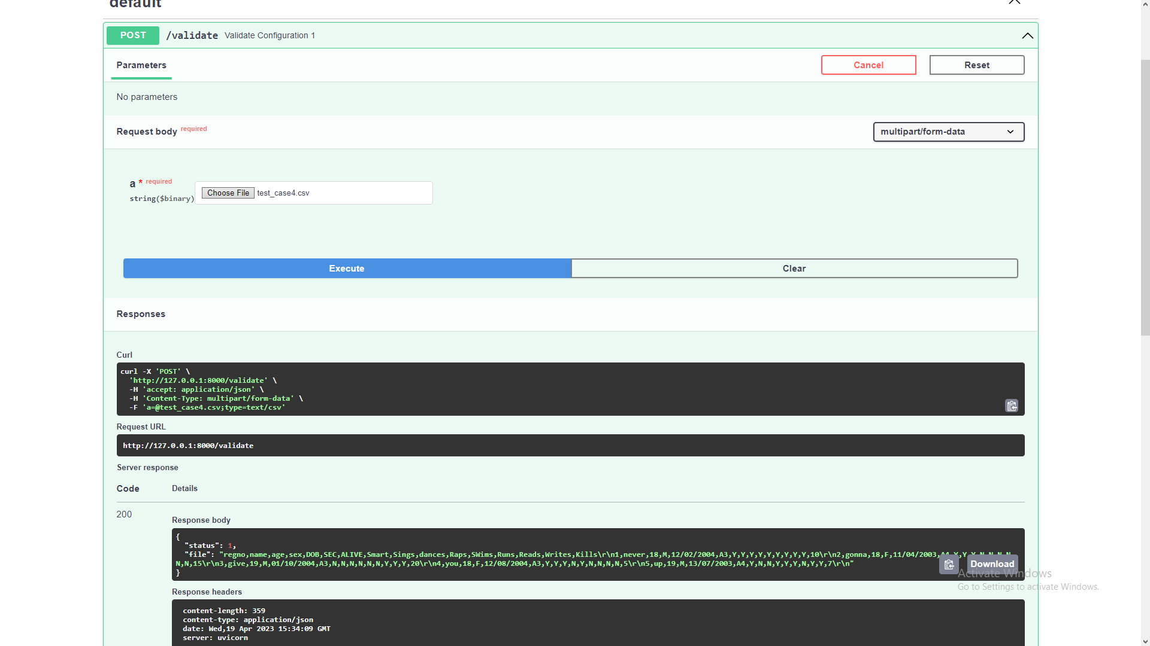
Output:

Slide 10
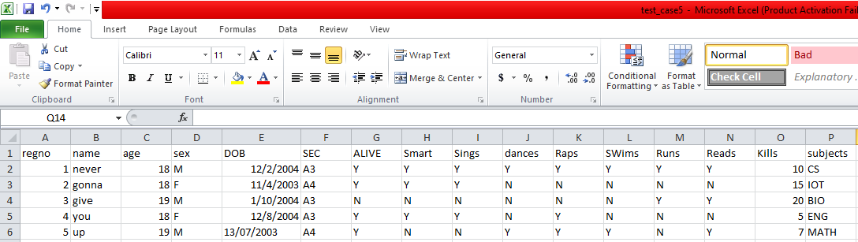
Test case 5
Validating a file with correct format
File
Config:

Slide 11

Output:

Slide 12
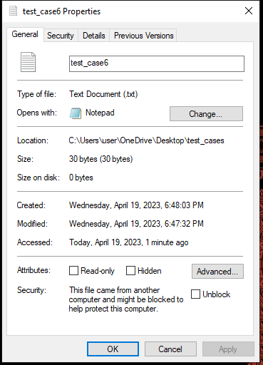
Test case 6
Validating a file with incorrect format
File:
Config:

Slide 13

Output:

Slide 14
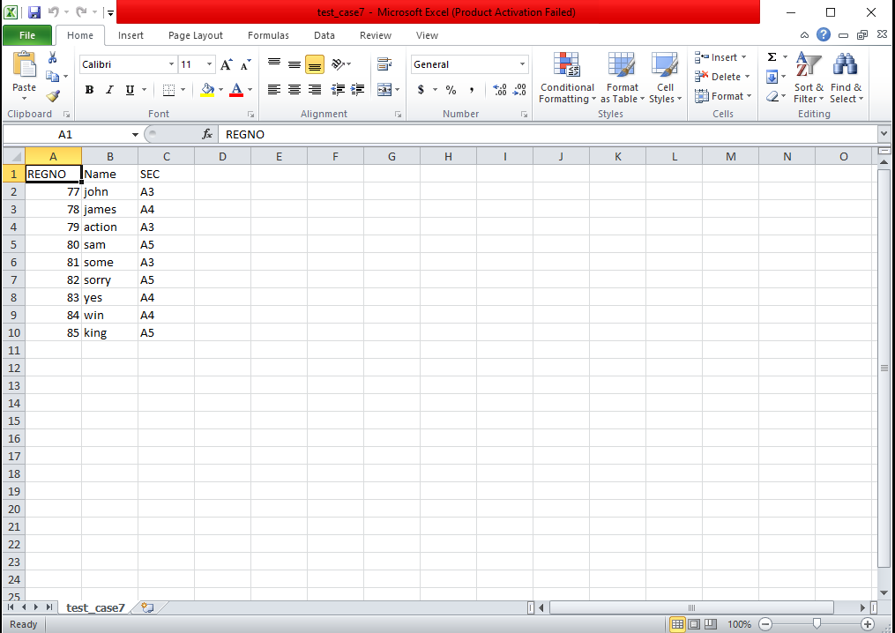
Test case 7
Validating a non-empty file
File:

Slide 15

Output:

Slide 16
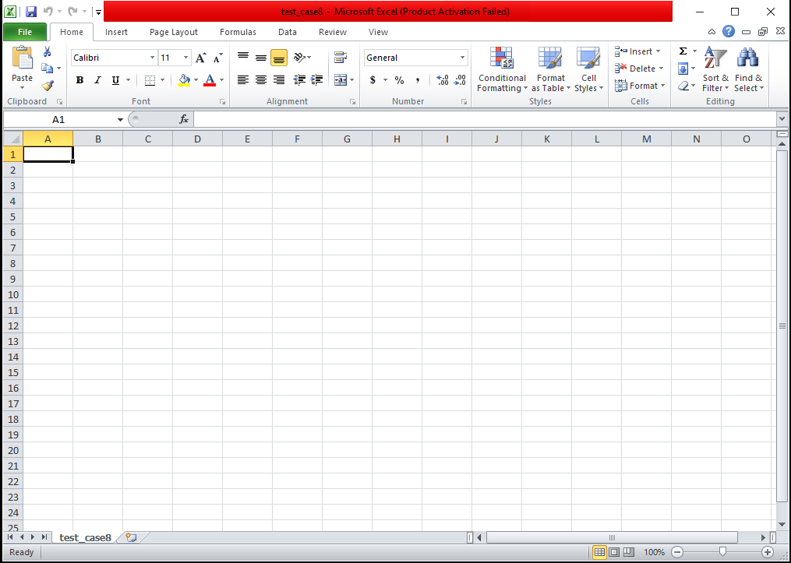
Test case 8
Validating a empty file
File:

Slide 17

Output:

Slide 18
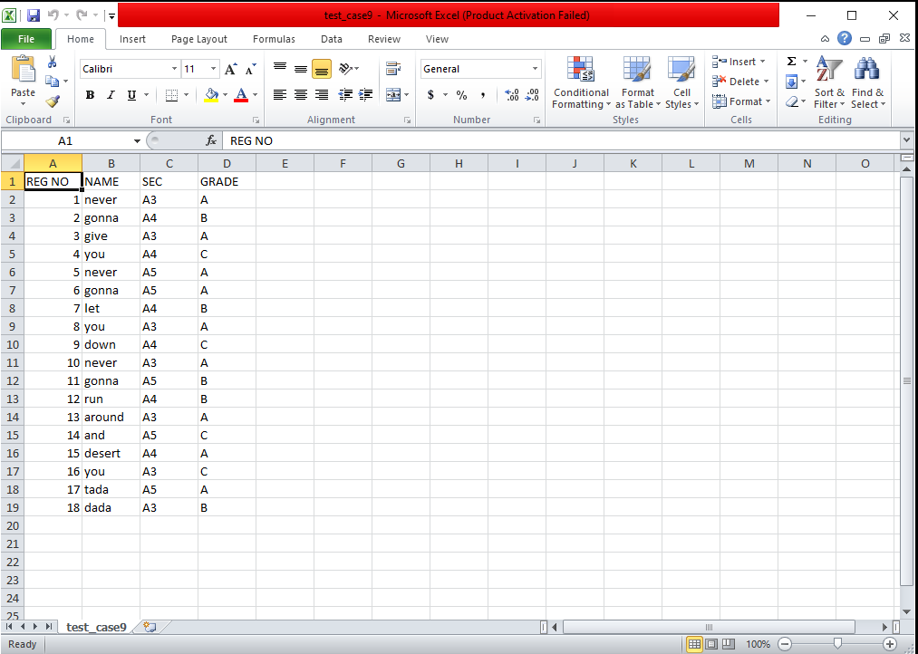

Test case 9
Validating a file with valid column length
File:
Config:

Slide 19
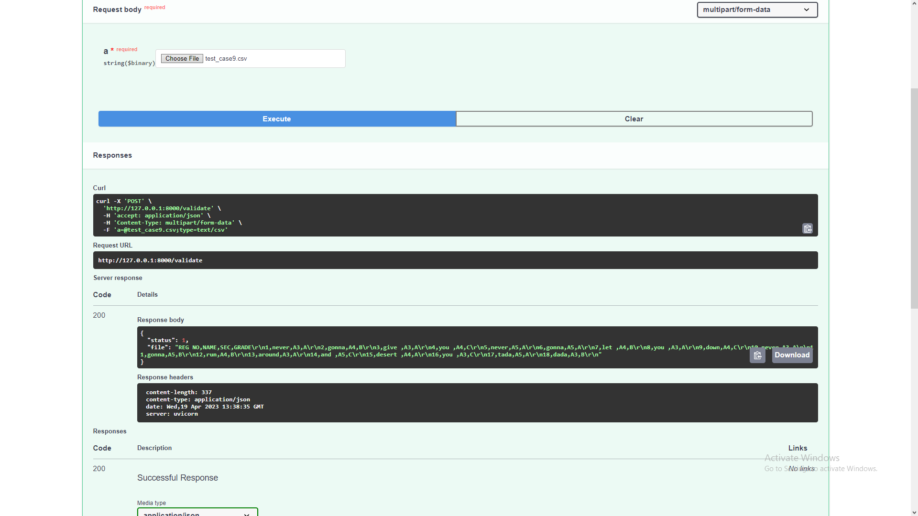
Output:

Slide 20
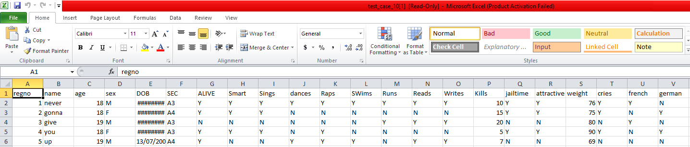
Test case 10
Validating a file with invalid column length
File:
Config:

Slide 21

Output:

Slide 22
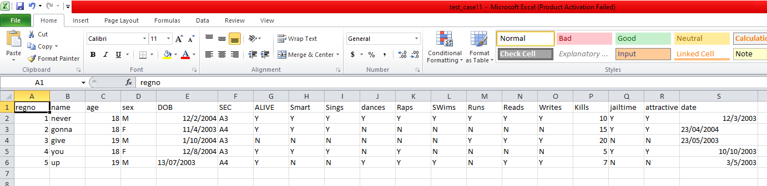

Test case 11
Validating files with date column that is in correct format
File:
Config:

Slide 23

Output:

Slide 24

Test case 12
Validating files with date column that is in incorrect format
File:
:
Config :

Slide 25

Output:
Config 1 output:

Slide 26
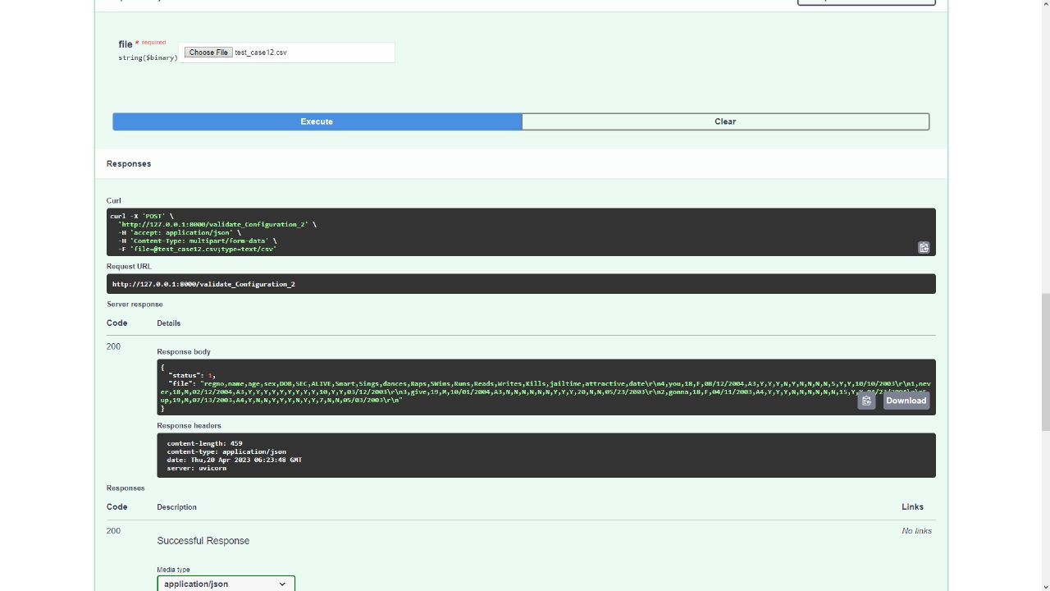
Config 2 output :

Slide 27
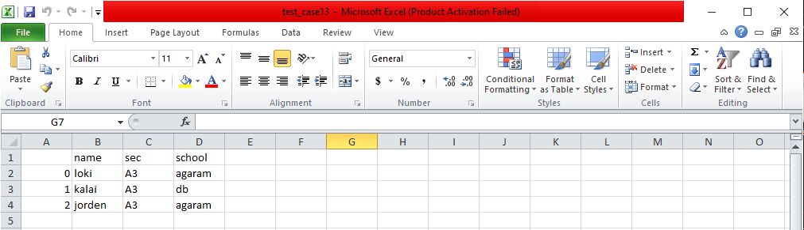

Test case 13
Validating a file with unique columns being unique
File:
Config:

Slide 28
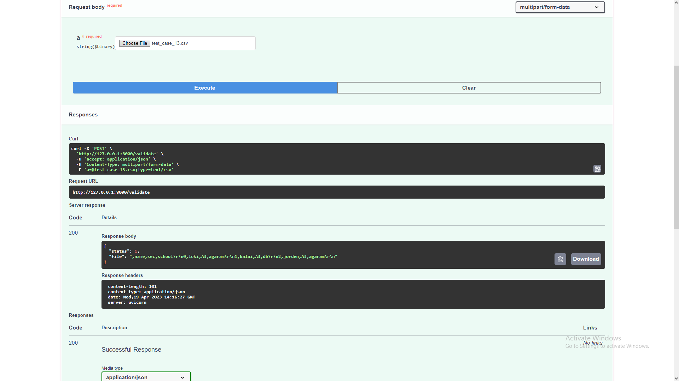
Output:

Slide 29
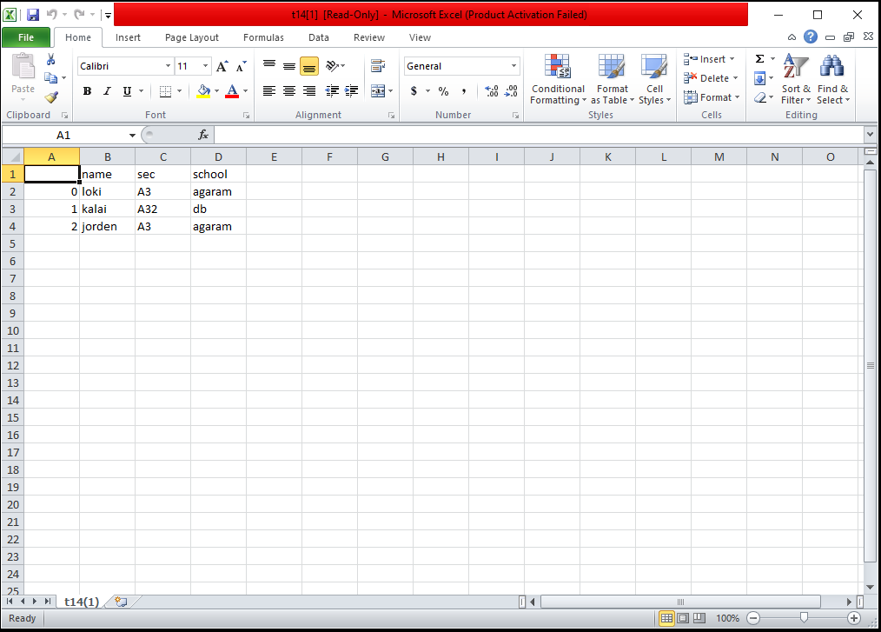

Test case 14
Validating a file with unique columns being not unique
File:
Config :

Slide 30

Output:

Slide 31
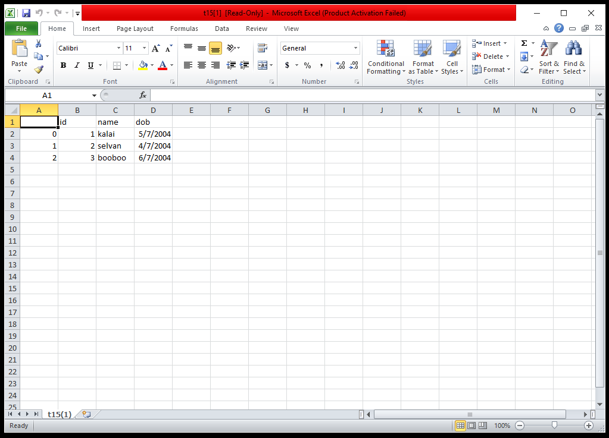
Test case 15
Validating a file with valid column data types
File:
Config:
Config :

Slide 32
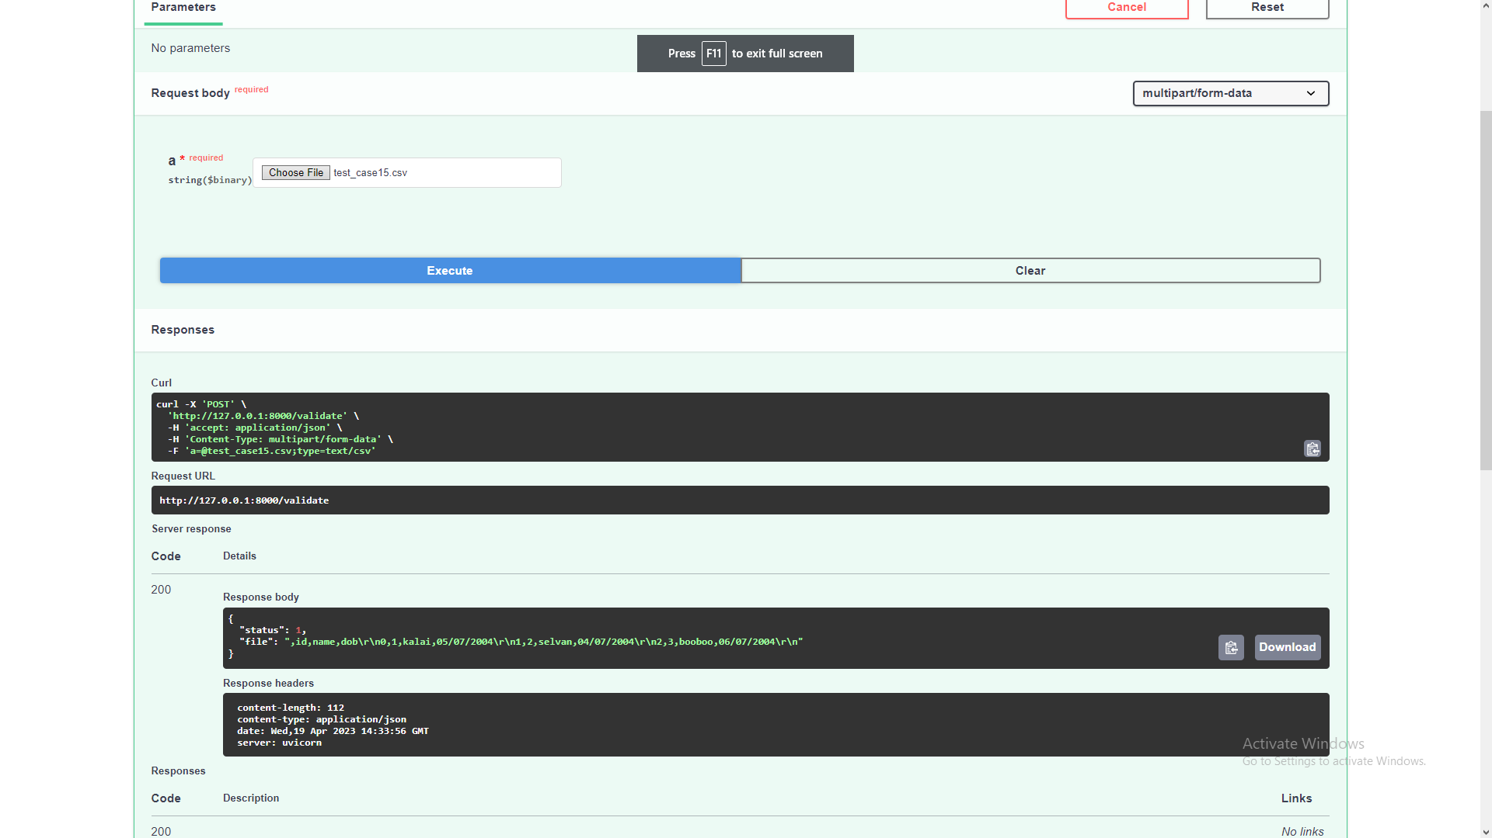
Output:

Slide 33
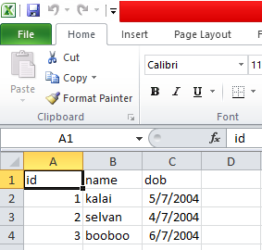
Test case 16
Validating a file with invalid column data types
File:
Config 1:
Config 2:

Slide 34

Config 1 output:

Slide 35
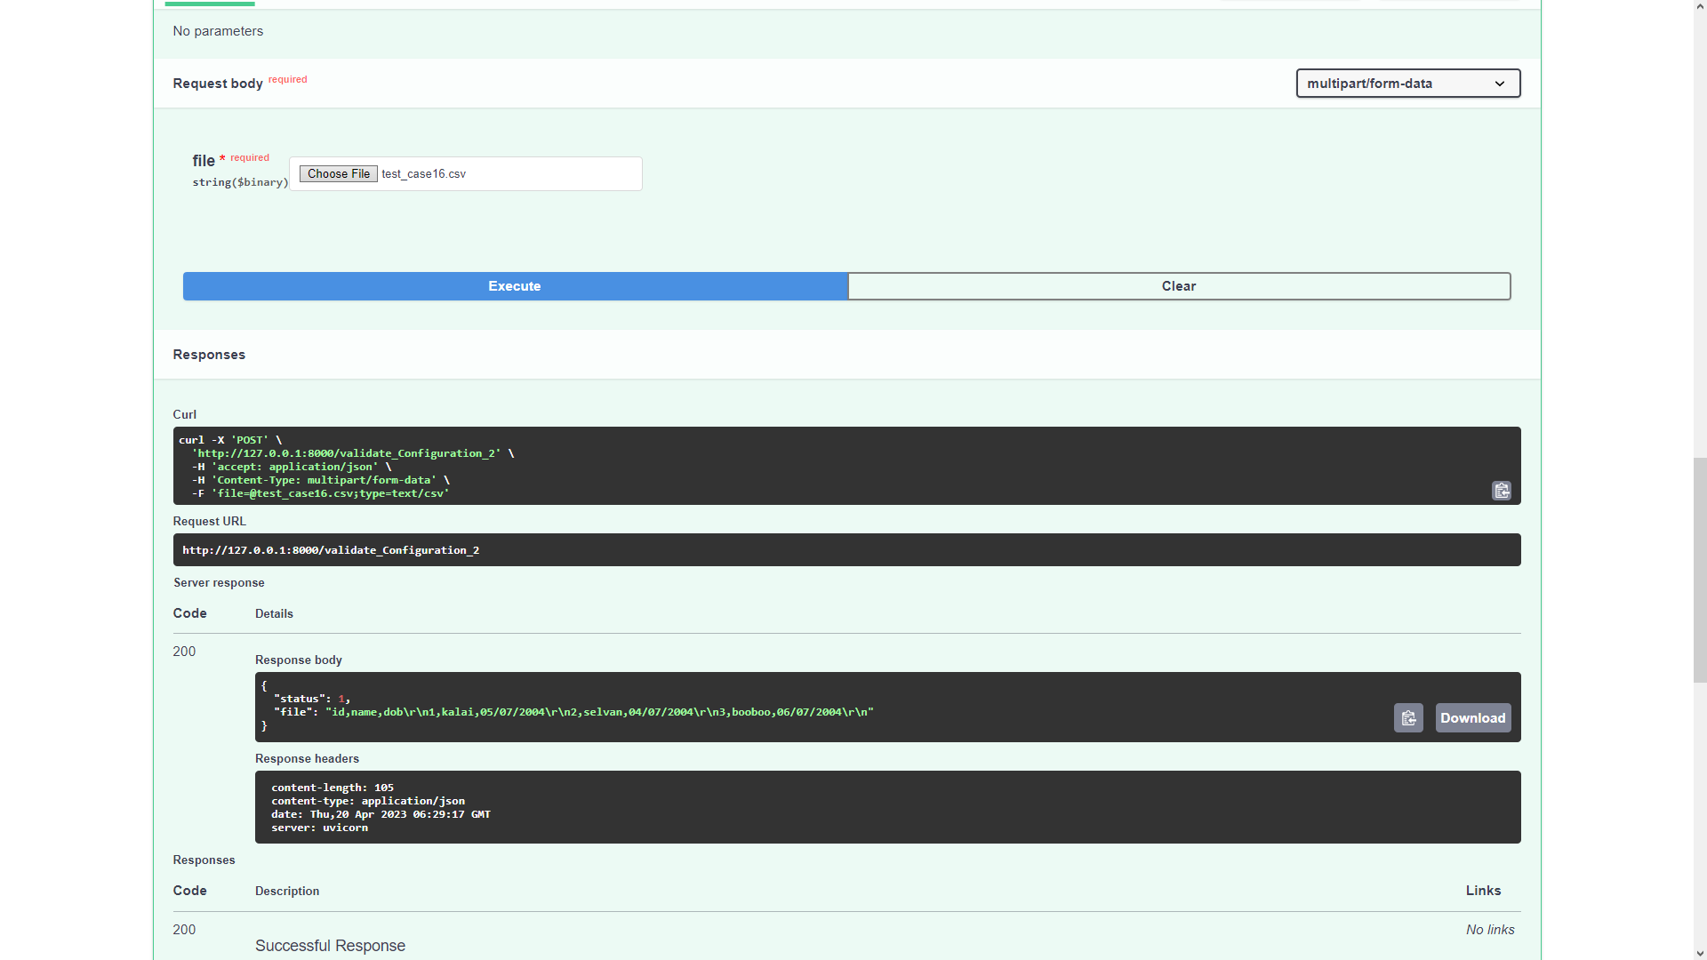
Config 2 ouptut:

Slide 36
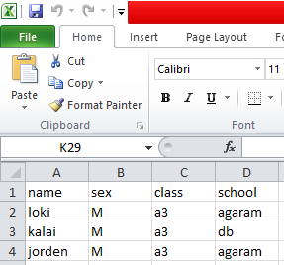
Test case 17
Validating a file with mandatory column
File:
Config:

Slide 37

Output:

Slide 38
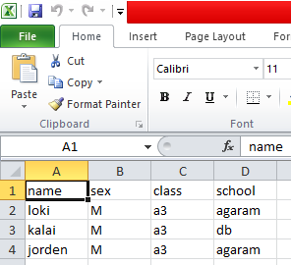
Test case 18
Validating a file without mandatory column
File:
Config:

Slide 39

Output:

Slide 40
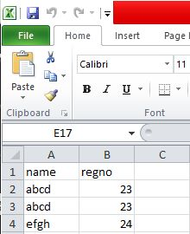
Test case 19
Validating a file with duplicate columns
File:

Slide 41
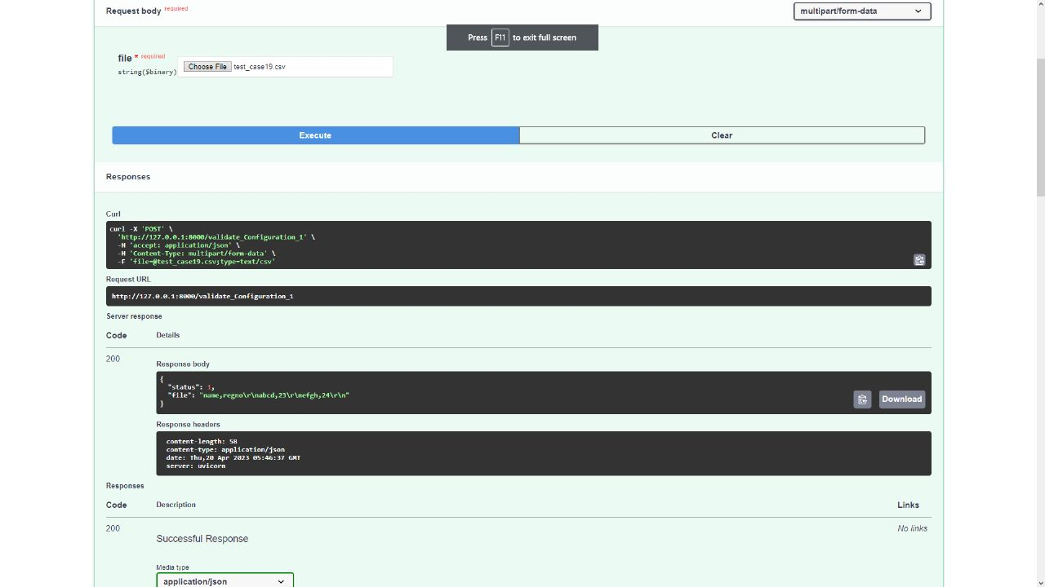
Output:

Slide 42
Xml Specific Test Cases

Slide 43
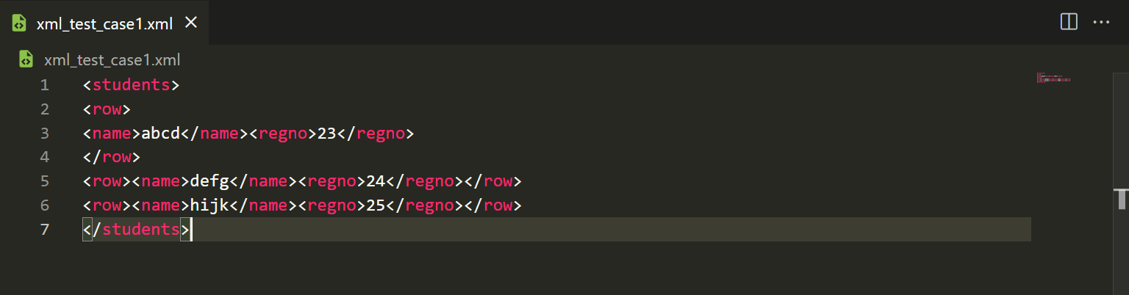
Test case 1
Validating a file without multivalued columns
File:

Slide 44

Output:

Slide 45
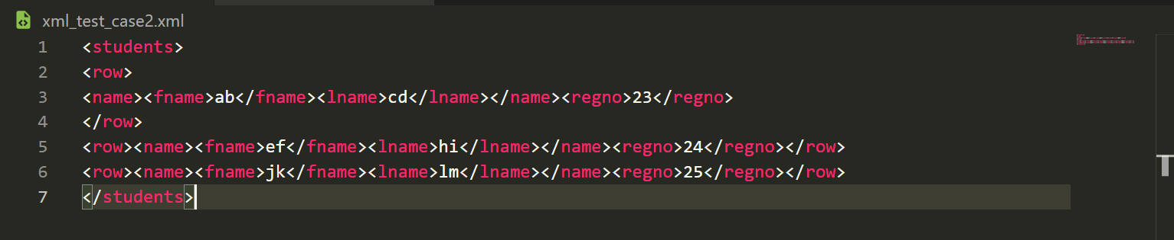
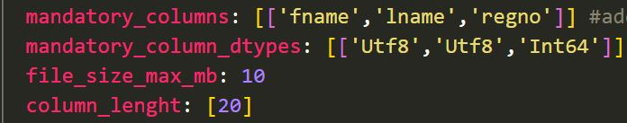
Test case 2
Validating a file with multivalued columns
File:
Config 2:

Slide 46

Config 1 Output:

Slide 47
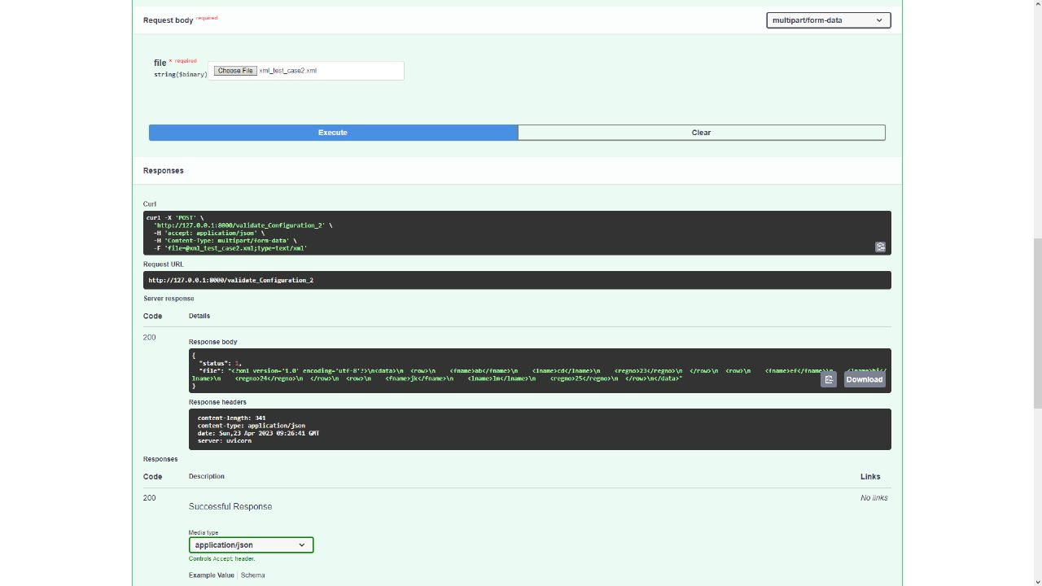
Config 2 ouput:

Slide 48
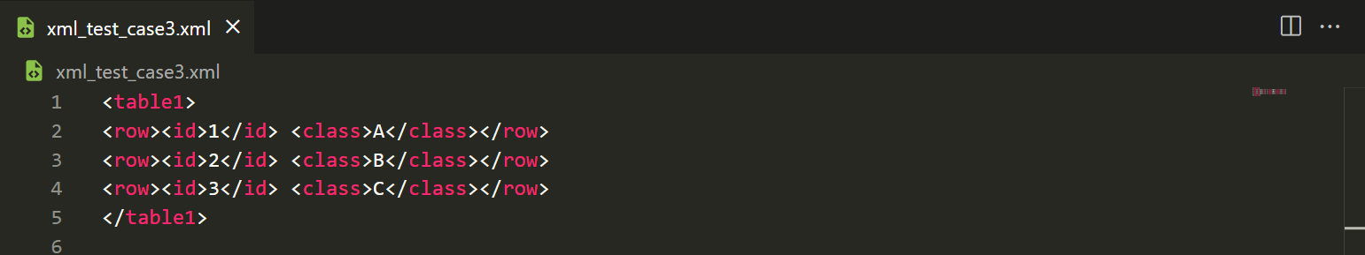
Test case 3
Validating a file without multiple tables
File:

Slide 49

Output:

Slide 50
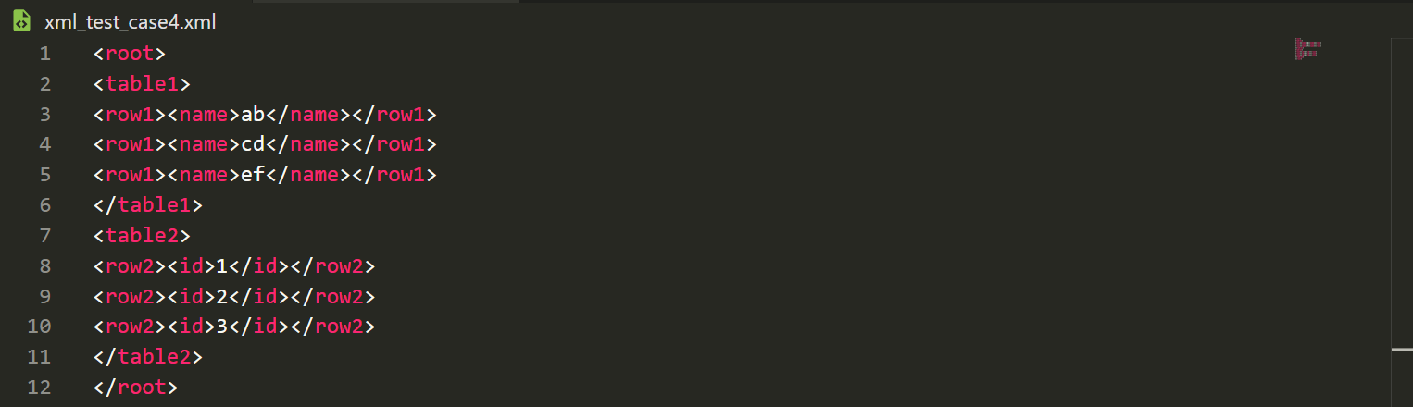
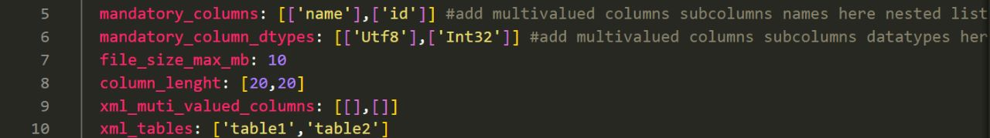
Test case 4
Validating a file with multiple tables
File:
Config 2:

Slide 51

Config 1 output:

Slide 52
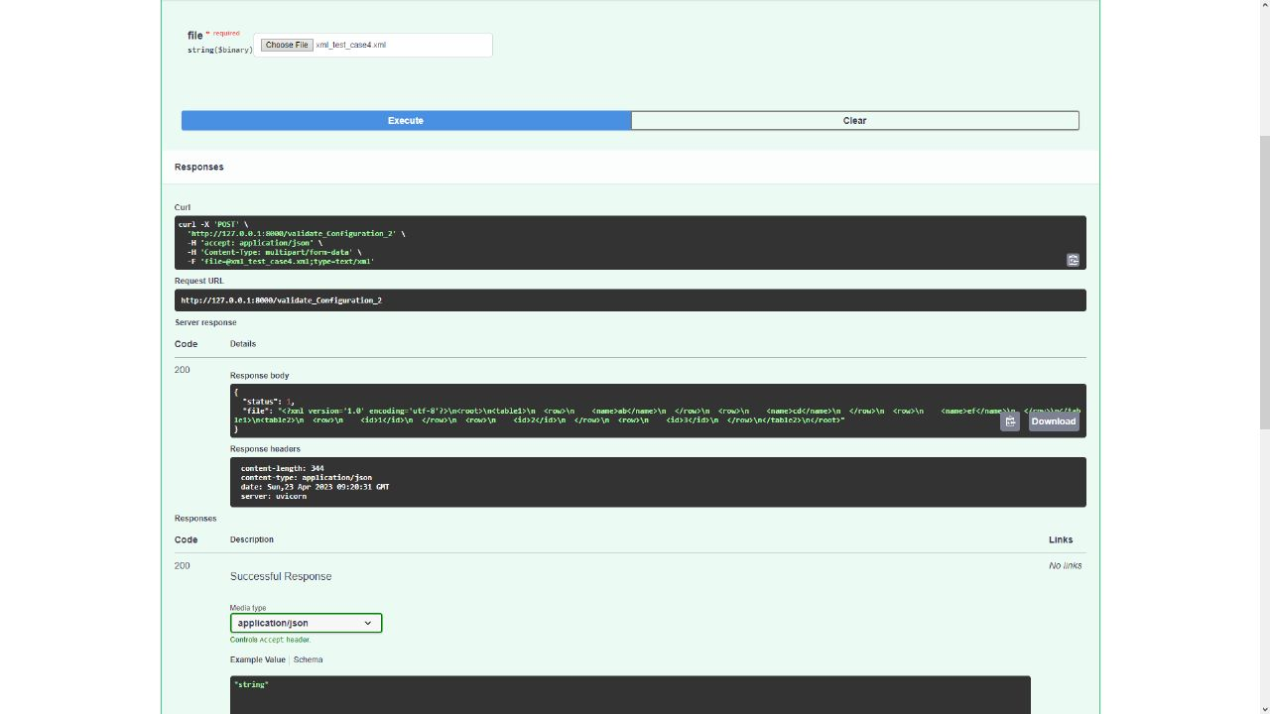
Config 2 ouput:

